Slide 1
Harmful Algae Bloom (HAB) Events vs Water Levels – Executive Presentation
Date: 02/27/2024
Presenter: Ashley Wilson-Rew

Slide 2
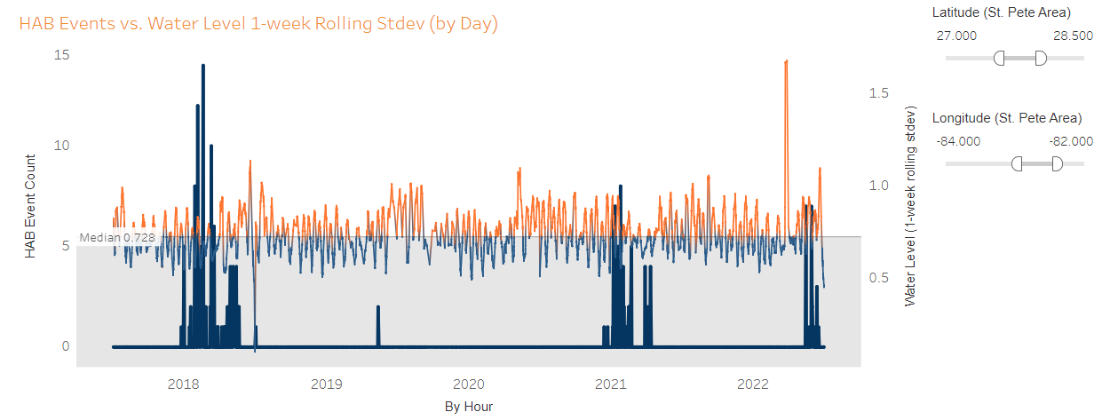
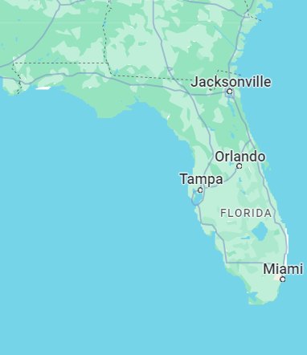
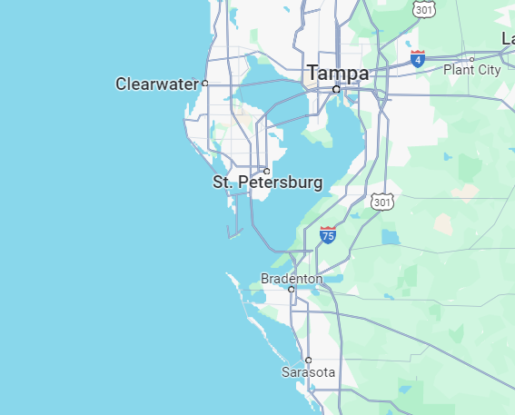

There were major harmful algae blooms (HABs)¹ in 2018, 2021, and 2022 in the St. Pete coastal area. Can we use changes in water levels² to predict HAB events in the interest of decreasing negative impacts to health and tourism?
Key Insights
Correlation
Time periods
Risk levels³
Source Note: ¹ HAB events data taken from FWC Recent Harmful Algal Bloom (HAB) Events 2015 - 2022
Source Note: ² Changes in water levels around St. Pete taken from NOAA Tides & Currents: Station 8726520 St. Petersburg, FL 2015 – 2022
Source Note: ³ HAB risk levels taken from WHO’s Guidelines for Safe Recreational Water Environments Chapter 8
Notes:
Reference sources.
Harmful algae blooms: 3k+ cells/mL
Low/no risk: <20k cells/mL
Med risk: 20k – 100k cells/mL
High risk: 100k+ cells/mL
Only St. Pete area of FL
Focusing on 2018 - 2022

Slide 3
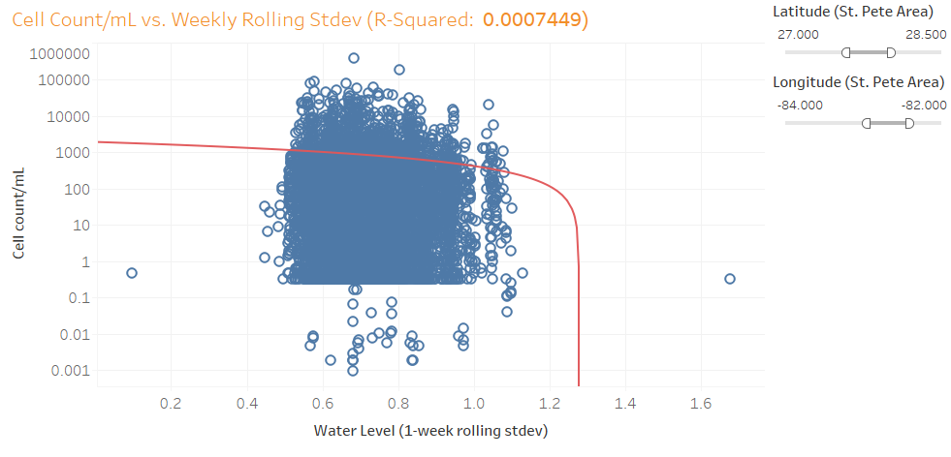
1 ) It does NOT appear that we will be able to predict HAB events through water level readings
Low R-squared value indicates low correlation
Used logarithmic scale on y-axis due to large outliers and many 0-value observations
Source: FWC Recent Harmful Algal Bloom (HAB) Events 2015 - 2022
Source: NOAA Tides & Currents: Station 8726520 St. Petersburg, FL 2015 – 2022
Source: WHO’s Guidelines for Safe Recreational Water Environments Chapter 8
Notes:
No apparent correlation between changing water levels and HABs
Other water-related variables may be more closely related to algae growth
Used log scale for cell counts - many 0 values and outliers

Slide 4
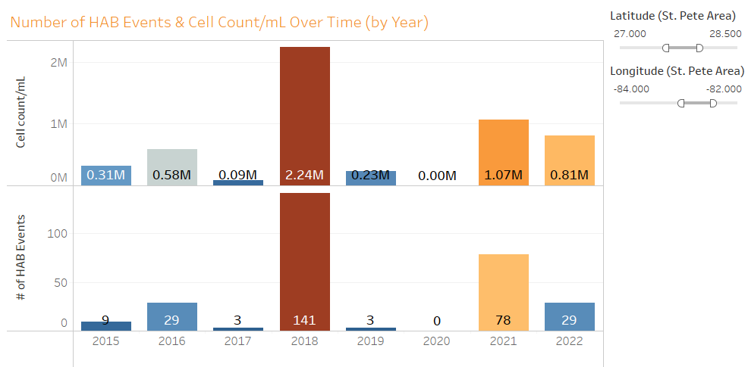
2 ) 2018 had the most recorded HAB events (141) and highest total algae growth (2.24M / mL)
2022 had high algae cell counts but fewer recorded HAB events
Source: FWC Recent Harmful Algal Bloom (HAB) Events 2015 - 2022
Source: NOAA Tides & Currents: Station 8726520 St. Petersburg, FL 2015 – 2022
Source: WHO’s Guidelines for Safe Recreational Water Environments Chapter 8
Notes:
2016 had as many events as 2022 but lower recorded cell counts

Slide 5
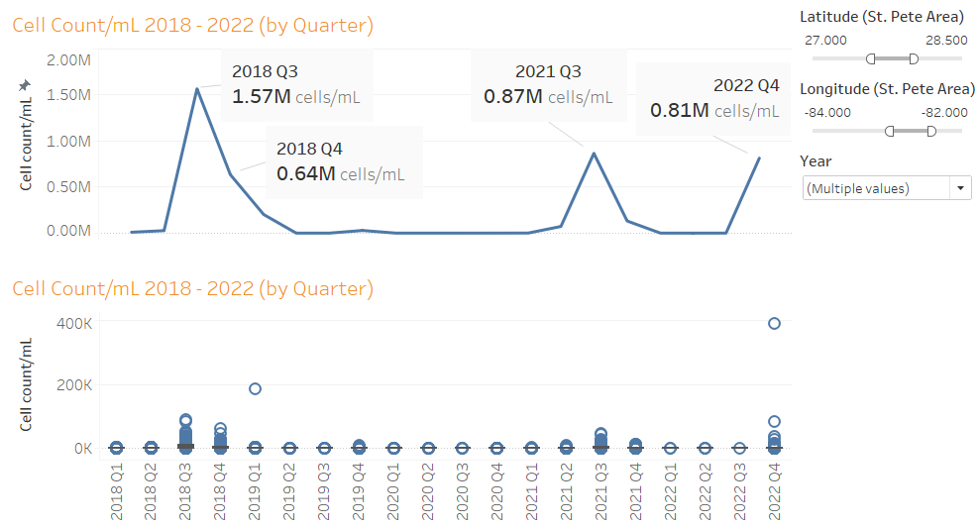
The longest running and largest volume of algae growth occurred from Q3 - Q4 2018 (2.21M cells/mL)
Q3 2021 and Q4 2022 had the next-highest total algae growth
These quarters also had the most outliers in cell count/mL
Source: FWC Recent Harmful Algal Bloom (HAB) Events 2015 - 2022
Source: NOAA Tides & Currents: Station 8726520 St. Petersburg, FL 2015 – 2022
Source: WHO’s Guidelines for Safe Recreational Water Environments Chapter 8
Notes:
We see a trend in HAB seasonality (Q3 & Q4)
2018 experienced an extreme algae bloom lasting from Jul 2018 – Jan 2019*
* This is the outlier we see in Q1 2019

Slide 6
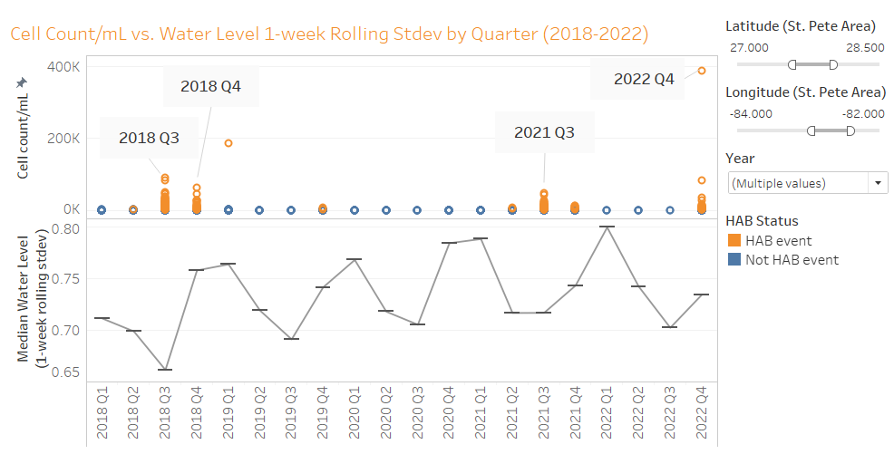
3 ) There appears to be some overlap in seasonality for HAB events and water level changes, though they are most likely NOT directly related
Water level measurements are more spread out YOY (standard deviation increasing)
Source: FWC Recent Harmful Algal Bloom (HAB) Events 2015 - 2022
Source: NOAA Tides & Currents: Station 8726520 St. Petersburg, FL 2015 – 2022
Source: WHO’s Guidelines for Safe Recreational Water Environments Chapter 8
Notes:
Water level changes also seem to have seasonality
Lower ranges of values in Q2 – Q3, higher ranges of values in Q4 – Q1
Measurements over time seem to indicate larger changes in water levels

Slide 7
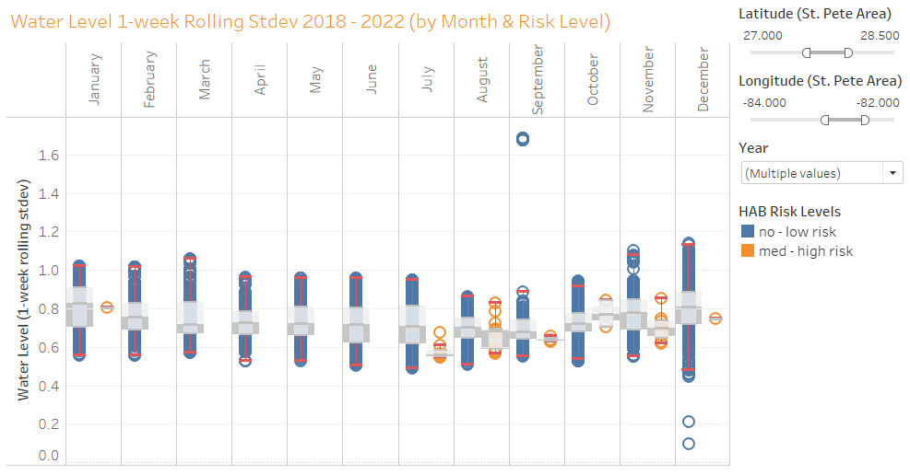
The months with the most HAB events (July and August) also had less fluctuation in water level measurements
From 2018 – 2022, there were no recorded HABs from Feb - Jun
Source: FWC Recent Harmful Algal Bloom (HAB) Events 2015 - 2022
Source: NOAA Tides & Currents: Station 8726520 St. Petersburg, FL 2015 – 2022
Source: WHO’s Guidelines for Safe Recreational Water Environments Chapter 8
Notes:
We tend to see higher algae cell counts in months where water levels do not change as drastically

Slide 8
While water levels do not appear to be correlated to HAB events, other variables may impact changing water levels and HAB growth (such as water temperature). This would require additional analysis.
HABs and water levels fluctuate on a similar seasonal basis
HABs more likely in Q3 and Q4
Can implement protection & prevention plans for individuals and businesses to mitigate negative effects of HABs
Rolling water level stdevs decrease in Q3 and increase in Q4
Water levels have been fluctuating more YOY
Help businesses prepare for the impact of larger changes in water levels
Since we know HAB events are more likely in Q3 and Q4, we can implement protection & prevention plans for individuals and businesses to mitigate the negative effects of harmful algae blooms.
Source: FWC Recent Harmful Algal Bloom (HAB) Events 2015 - 2022
Source: NOAA Tides & Currents: Station 8726520 St. Petersburg, FL 2015 – 2022
Source: WHO’s Guidelines for Safe Recreational Water Environments Chapter 8

